Slide 1
State 4-H Portfolio
Teresa Dean
Doña Ana county

Slide 2
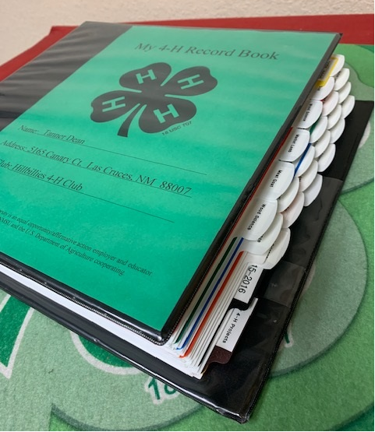
PORTFOLIO:
Covers your entire 4-H career.
There is no minimum number of years youth have to be a member or submitted a county record book.
Books are evaluated based on growth in the timeframe included in their book.
Must be a
Senior member in order to submit a portfolio.
Due in January at
Senior Leadership
Retreat.

Slide 3
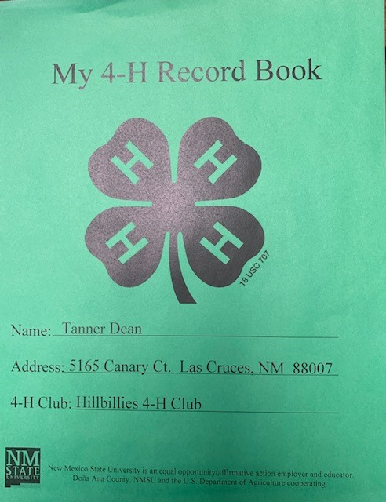
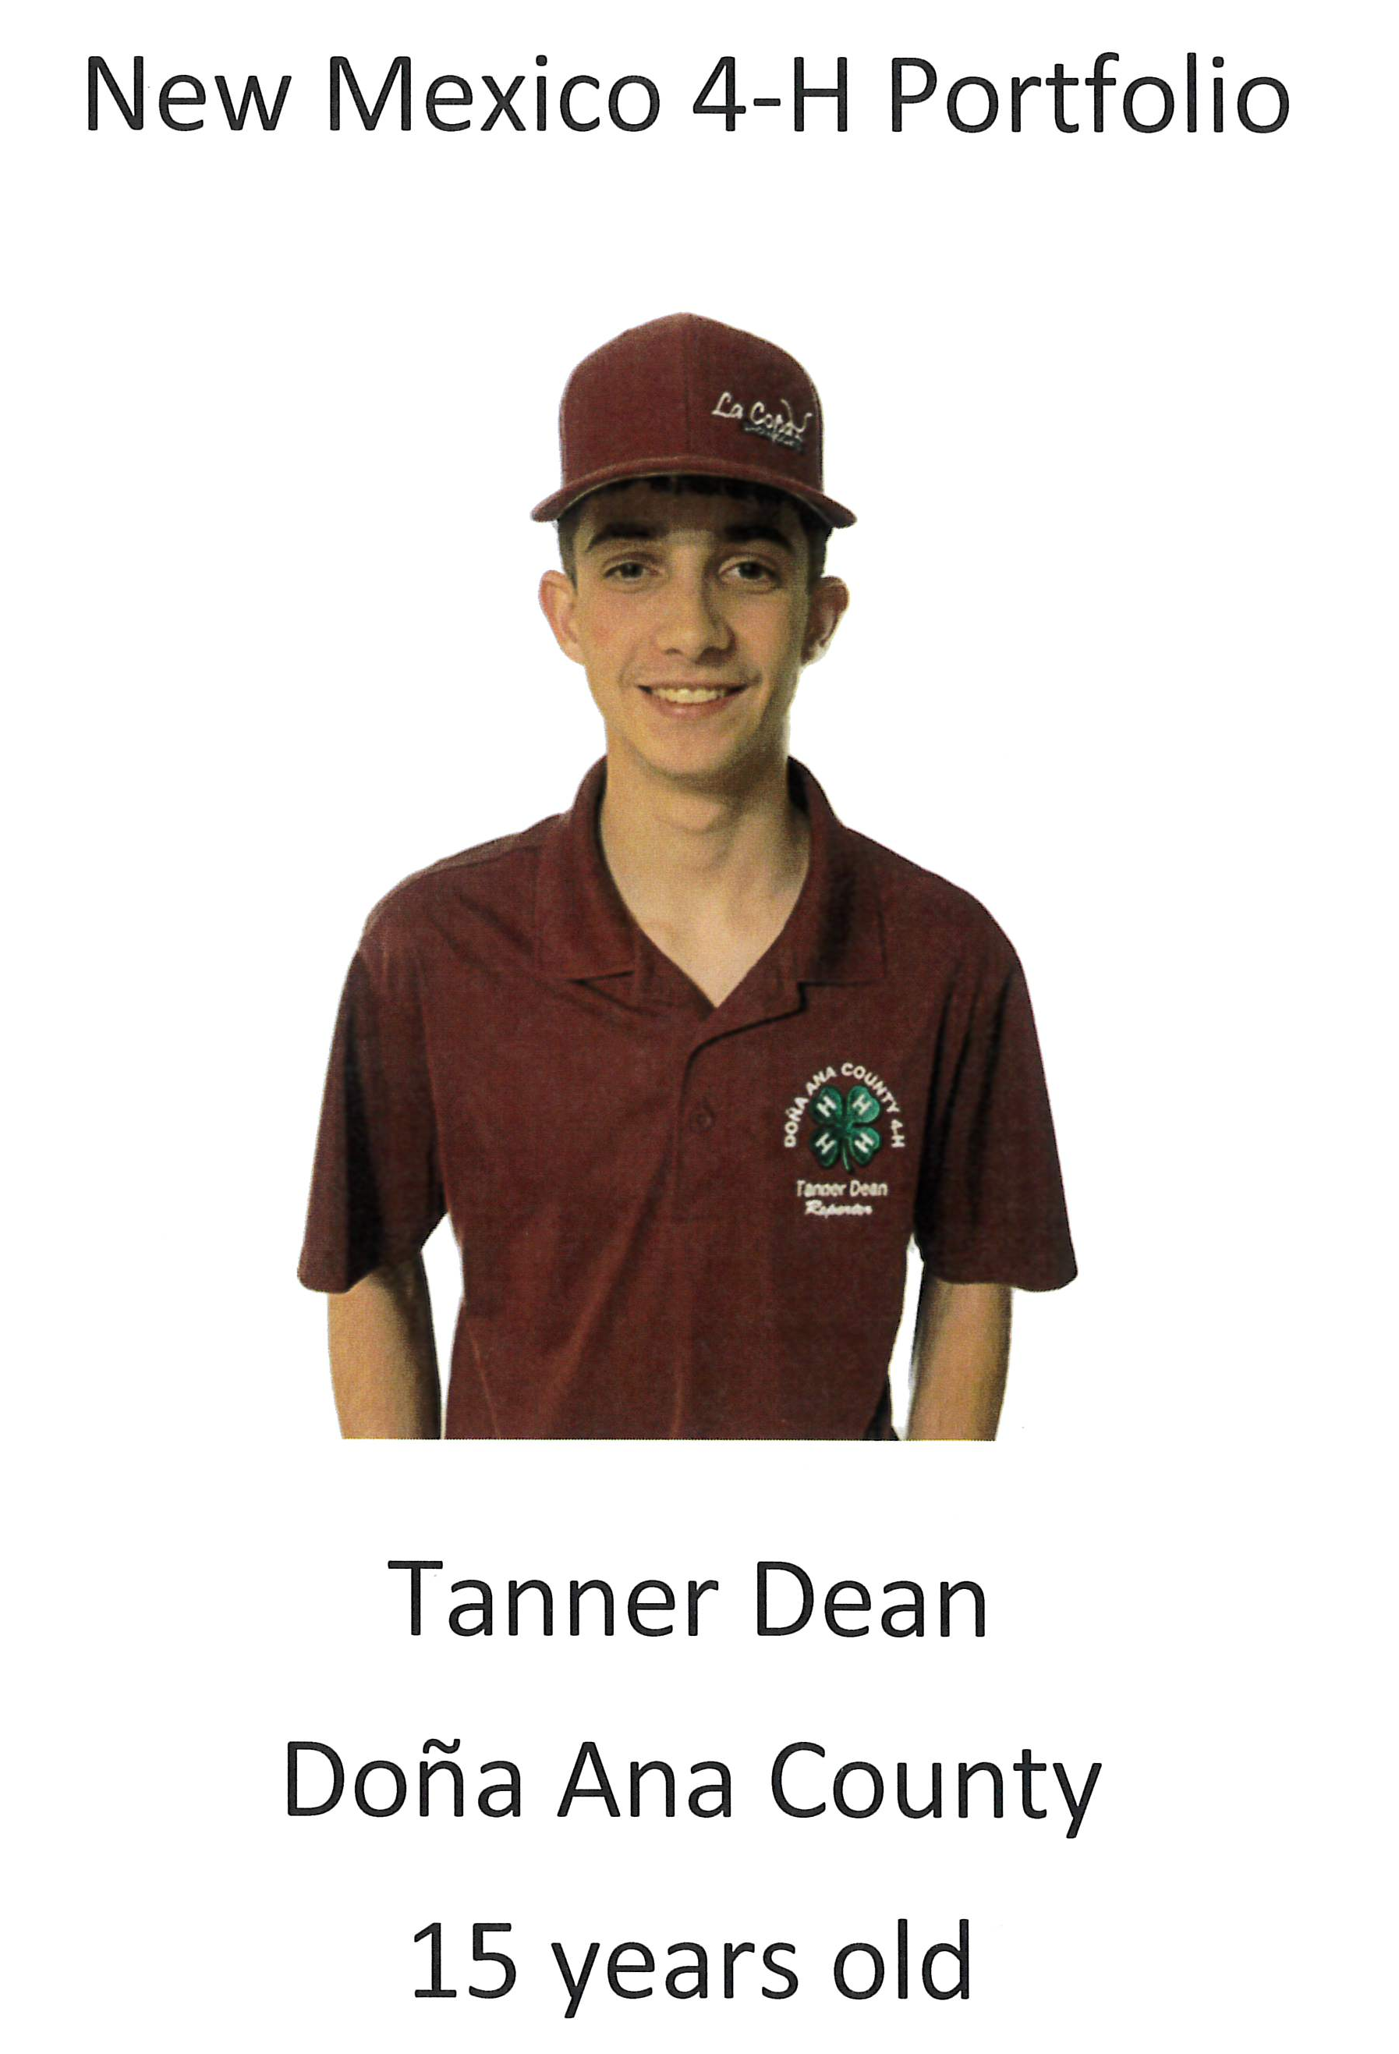
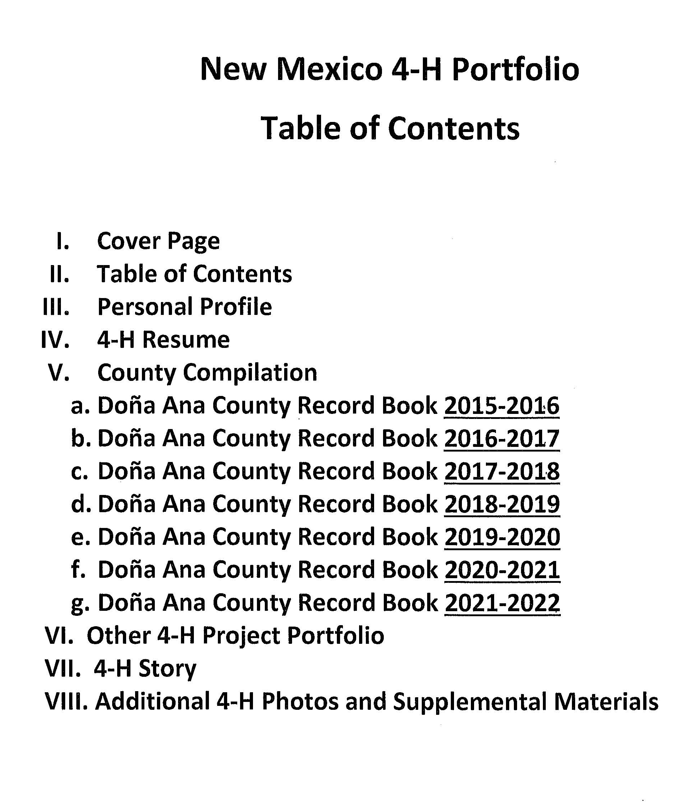
Portfolios can be submitted in two formats: State 4-H Format or County Compilation
The portfolio must include the following, REGARDLESS OF THE FORMAT YOU CHOOSE!

Slide 4
OBTAIN ALL SIGNATURES!
FOLLOW THE FORMAT!

Slide 5
What needs to be included?
State 4-H Format
County Compilation Format
Forms are available in a separate Word Document.
NM 4-H Portfolio Section Forms.
Leadership Profile
Citizenship/Community Service Profile
Project Profile
Submit county record books as originally completed.
Three projects in each year- projects should remain consistent across the years.
All sections of the record book must be included:
Leadership
Citizenship/Community Service
Projects Sheets
*NM 4-H Portfolio Project Summary Form-Use this form ONLY if you do not have original records from previous years.
A member may include up to three separate projects.

Slide 6
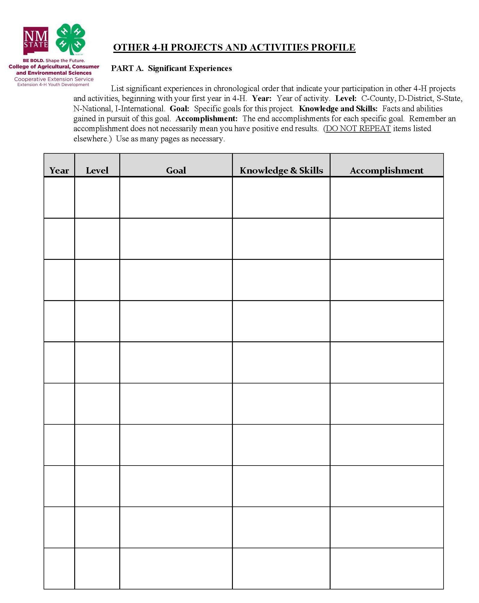
Also include….
Other 4-H projects and Activities Profile
4-H Story
Written
Video
Digital Media
Photos and Support material
No more than three pages total.
Member must document at least one project but not more than five additional projects over their 4-H career.

Slide 7
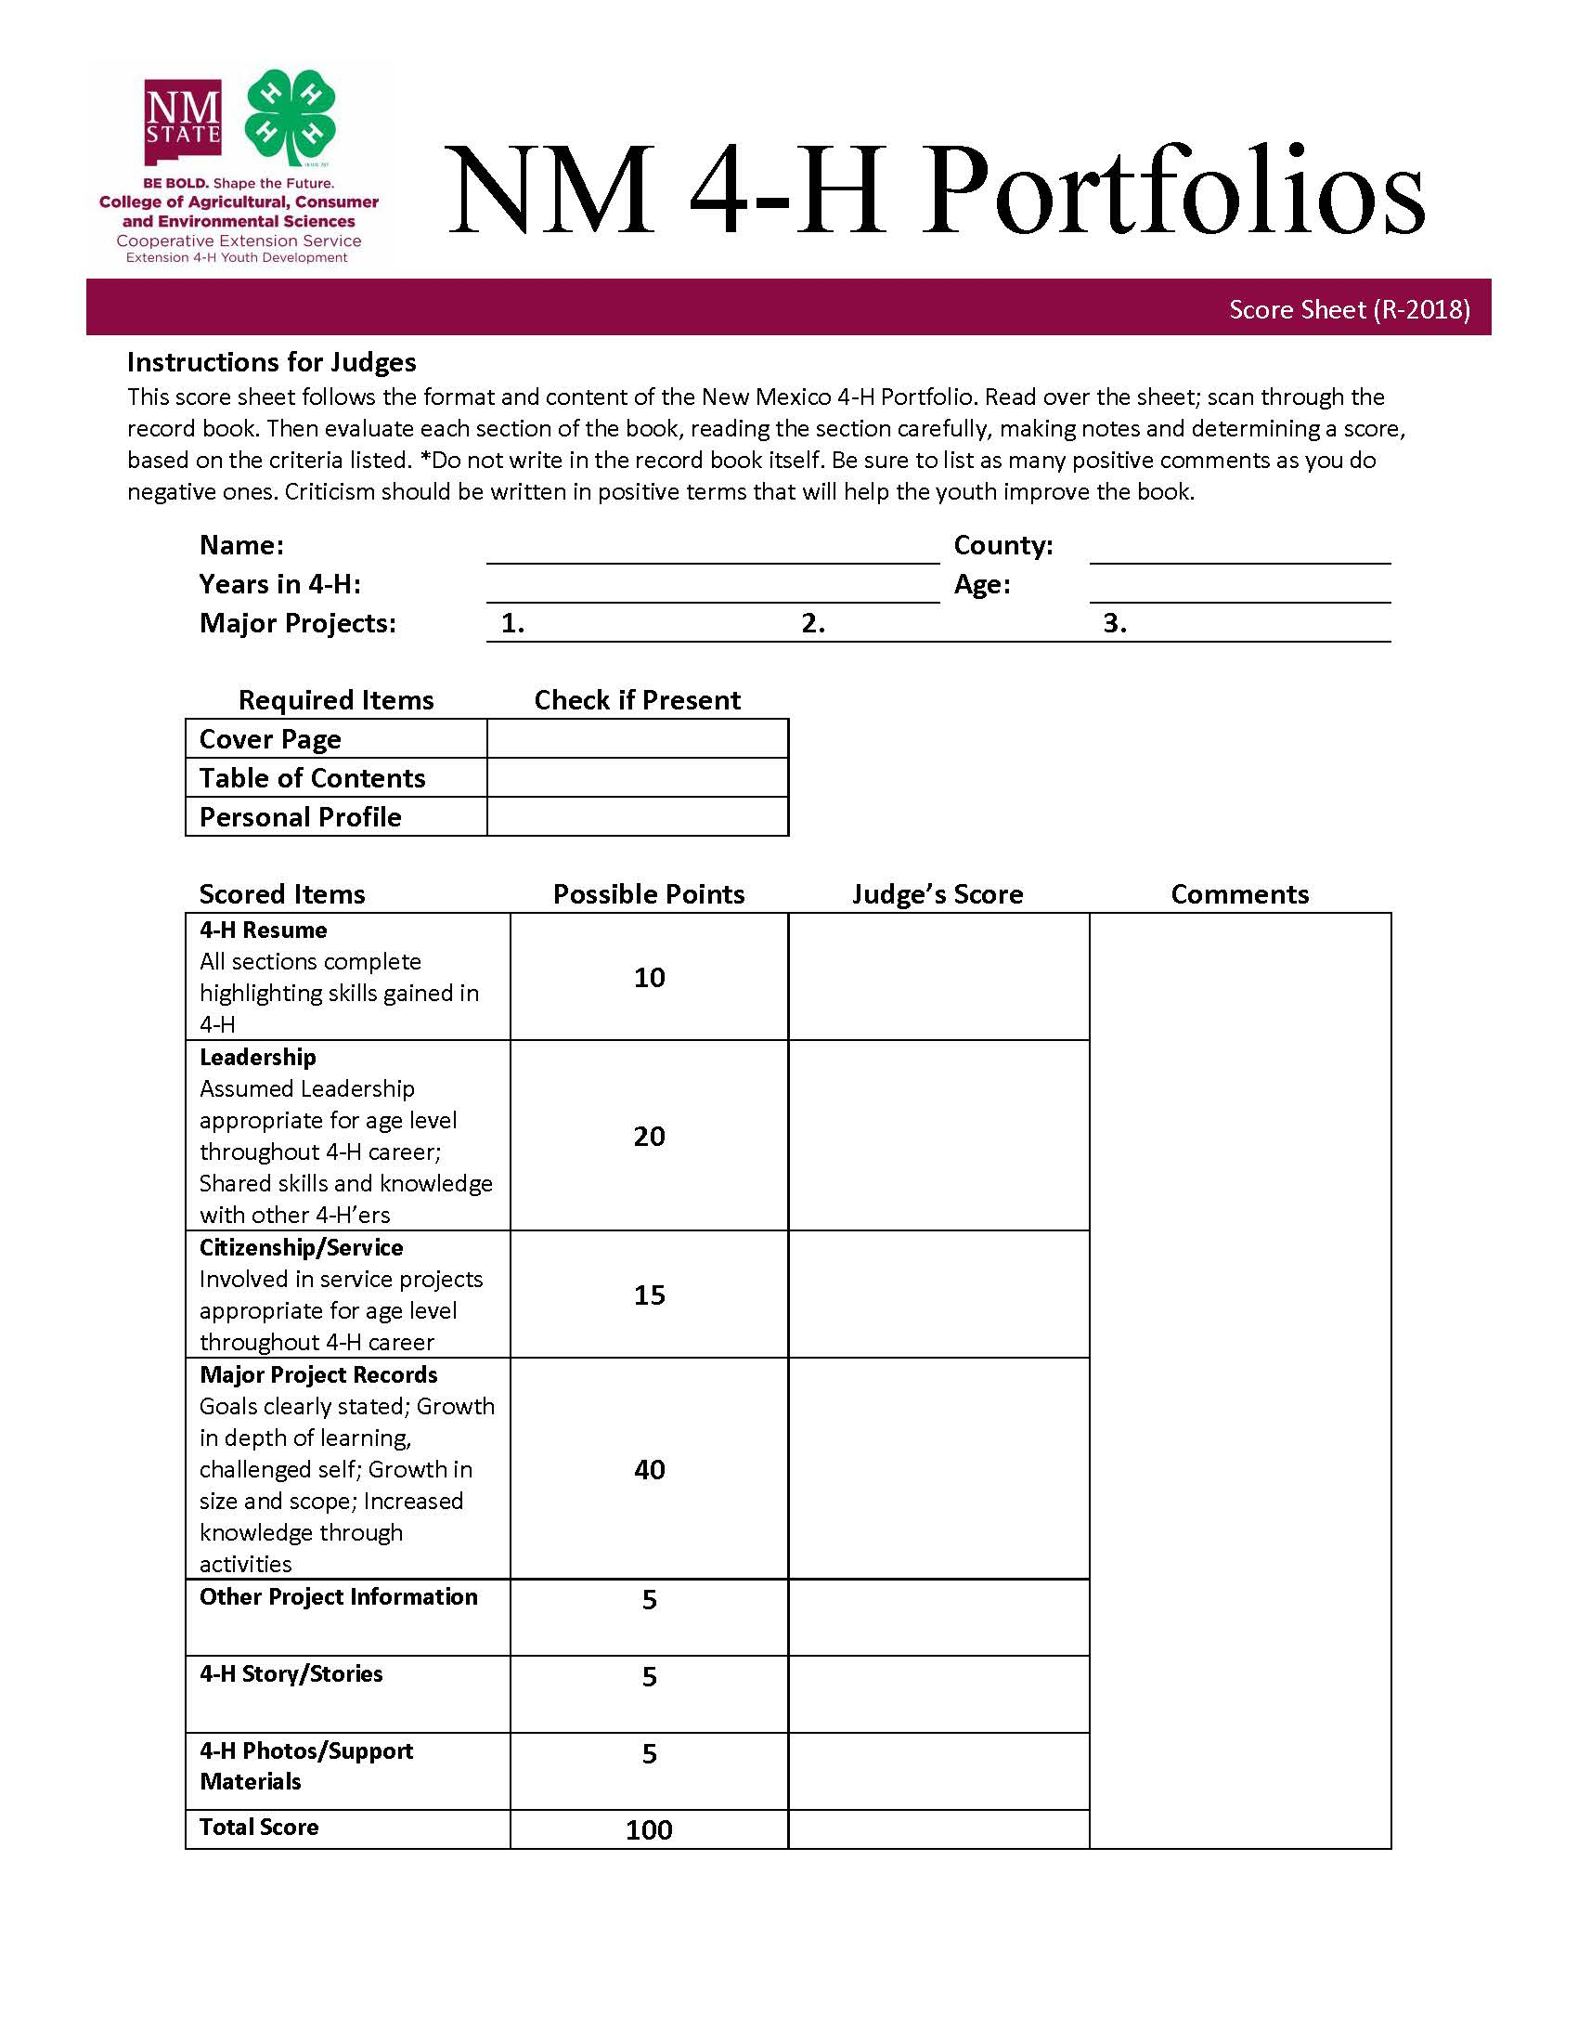
Additional Information
NM 4-H Portfolio Forms and Instructions can be found on the NM 4-H website in the “Forms and Publications Section.”
https://nm4h.nmsu.edu/policies/forms.html
Project Record Sheets can be found at:
https://4hprojects.nmsu.edu/index.html
Under the “Printable Project Resources” section, click on Project Forms.

Slide 8
Questions?

